Slide 1

Green Pace
Security Policy Presentation
Developer: Ryan Mitchell
“Security starts at the beginning”

Slide 2

OVERVIEW: DEFENSE IN DEPTH
When the idea of a project is created, the time for security development begins.
Defense is not left for the end, it is integrated at all stages.
Layered protection is equivalent to having a back up plan

Slide 3
THREATS MATRIX
Here we can define what threats are most active, and which are most detrimental.
Likely Data without bounds checking Mistyped strings SQL Injection Freed memory access Data transmission without validation | Priority Mistyped strings SQL Injection Freed memory access Data transmission without validation Hard coded sensitive information
Low priority Parsing errors Uncaught exceptions Improper syntax/declarations Improper naming conventions | Unlikely Parsing errors Improper syntax/declarations Improper naming conventions

Slide 4
10 PRINCIPLES
Validate Input Data
Data Types, String Correctness, SQL Injection, Assertions, Exceptions
Heed Compiler Warnings
Data Value, Memory Protection, Syntax
Architect and Design for Security Policies
SQL Injection, Sensitive Information
Keep it Simple
String Correctness, Syntax, Strict Definitions
Default Deny
Sensitive Information
Adhere to the system of least privilege
Sensitive Information
Sanitize Data Sent to Other Systems
SQL Injection
Practice Defense in Depth
SQL Injections, Sensitive Information
Use Effective Quality Assurance Techniques
Data Value, Exceptions
Adopt a Secure Coding Standard
Memory Protection, Assertions, Exceptions, Syntax, Strict Definitions

Slide 5
CODING STANDARDS
**Ranked by Priority
Sensitive Information: Never hard code sensitive information
SQL Injection: Exclude user input from format strings
Memory Protection: Do not access freed memory
Data Value: Ensure that unsigned integers do not wrap
Exceptions: Handle all exceptions
Assertions: Guarantee that storage for strings has sufficient space for character data and the null terminator
Data Type: Detect errors when converting a string to a number
String Corrections: Do not confuse narrow and wide character strings and functions
Strict Definitions: Obey the one-definition rule
Syntax: Do not write syntactically ambiguous declarations

Slide 6
ENCRYPTION POLICIES
Our new security policy will ensure that encryption techniques will be applied thoroughly to ensure company data stays protected
Encryption at rest:
Data is “in the safe”, and encrypted using a cipher algorithm.
Encryption in flight:
Data is in transit from one location to another, like an armored car for the bank. Data will also be encrypted during this stage.
Encryption in use:
Data is out like an open book while a company administrator accesses it. Naturally this is unavoidable. Employees will ensure that they are using a secure environment before decryption.

Slide 7
TRIPLE-A POLICIES
The three A’s:
Authentication: Company officials will register and maintain an account with a valid username, and password, with periodic updates.
Authorization: Company accounts will only be authorized to perform system tasks on a “principle of least privilege” basis.
**Contact system administrator about requesting certain account permissions
Accounting: Not finances, we’re talking moderating and system oversight. Sessions statistics and usage information will be monitored, to ensure employees are kept away from any dangerous sites, and to identify any unusual behavior.

Slide 8
Unit Testing
Part of secure coding is coding securely, and one of the many sayings you may have heard thrown around is “don’t leave defense until the end”.
We will briefly demonstrate the effectiveness that the simple inclusion of unit testing and assertions will help us to detect any exceptions, and locate them precisely.
Please familiarize yourself with the syntax and declarations. Function names are decidedly specific to the condition being tested.

Slide 9
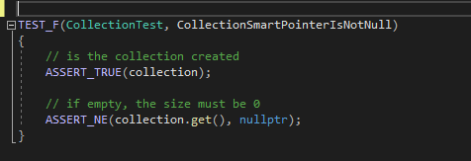
Unit Test 1: Is our smart pointer not null?
**Assert_NE = Not equal

Slide 10
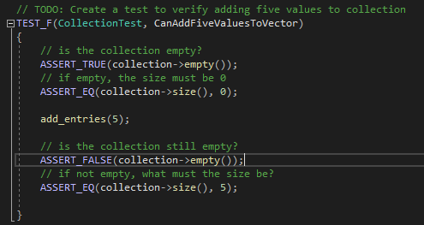
Unit Test 2: Can we add x values to our container?
We all know vectors have the useful property of being able to dynamically resize, but what if we used an array? It is important to test that data structures are as predictable as can be.
Console Output:

Slide 11
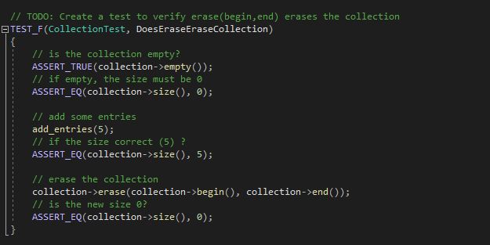

Unit Test 3: Is our collection properly erased?
With the many languages, many integrated functions, many different types of syntax, things can be lost along the way. It is important to verify that deletion occurs as intended to leave no trace for black hats.

Slide 12
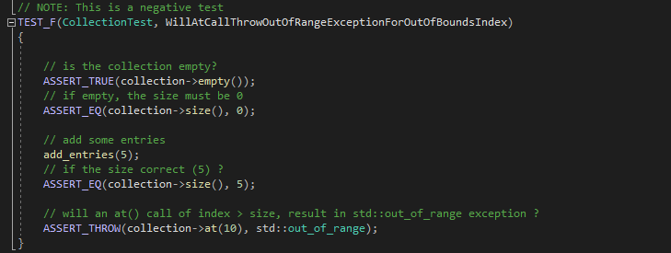
Unit Test 4: Will this action produce an exception?
It is important to also utilize negative tests when applicable as a way of asserting that a behavior WOULD cause issues.

Slide 13
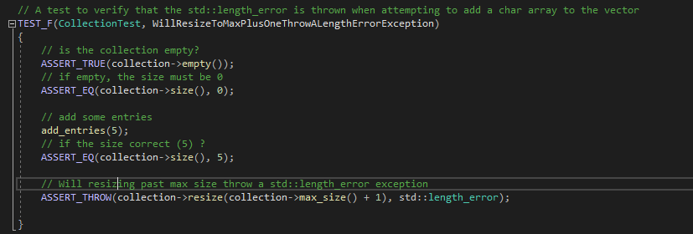
Unit Test 5: Bounds checking, and asserting min/max
We cannot emphasize enough how important it is to check our bounds, to ensure that containers will fit, and that buffers are not overflown.

Slide 14

AUTOMATION SUMMARY

Slide 15
TOOLS
The DevSecOps toolchain is a strong one, but could use some clarifications.
Pre-production:
Assess and plan: Develop security plan and risk levels
Design/Build: Include testing designs and building environments with the right tools to debug
Verify and test: Utilizing our automated systems and properly utilizing all available resources to check for vulnerabilities
Production:
Transition/Health Check: Official configuration and deployment of security protocols
Monitor and detect: Constant checking for any unexpected behavior or anomalies
Respond: Our well equipped security team will be first to attempt to address and resolve and security or data breaches
Maintain and stabilize: Reevaluate the necessary measures to improve future security

Slide 16
RISKS AND BENEFITS
If we assume that security can wait until later:
We can focus on product design and performance
Product development to testing timeline reduced
BUT
Testers and developers won’t be on the same page
More bugs may exist
If we act now, and promote security throughout:
Developers and testers will have more opportunities to collaborate
More bugs will be caught AND prevented before they can even exist
Final deliverable will be much more reliable and safe
BUT
Timelines will most likely be extended
Developers will be required to familiarize themselves with another set of tools and language
It is more work, but it is for the sake of the bigger picture. By working hard now, we make that it will not be undone later

Slide 17
RECOMMENDATIONS
As the cyber threats inevitably grow and evolve, we must be dynamic in our approach and our mindset. We will never be able to predict where threats will come from with 100% certainty, but we can steadily build a strong foundation to grow and internalize these new techniques
If you are a developer or administrator with a high degree of privilege, I recommend you keep track of any and all public accounts such as social media, email, etc. While on site security will be strong, we all return to the real world at the end of the day.
In addition to public accounts, keep all electronic devices with internet capabilities secure.
For those of you who will or have to work from home, ensure that your private network is secure, or use a virtual private network (VPN) to help encrypt your internet activity.
Security protects from most direct avenues, but always be conscious of any sort of strange communication or any attempts at coercing information of you. Ensure that all individuals are who they claim to be.

Slide 18
CONCLUSIONS
It is important to remember that we are all human. Security principles will not only help us achieve our goal, but promote its longevity.
Security principles will not only help protect us, but it will protect our user base.
If you unsure about a new policy, or you notice someone who is not following it, please do not be afraid to inquire. We should all be on the same team.
Work hard, code carefully, keep our secrets safe, and practice vigilance.
Change can be hard, but we must allow ourselves to feel uncomfortable. Once it becomes comfortable again, that will be growth.

Slide 19
REFERENCES
SEI CERT C++ Coding Standard
Schiela, R. (2020, May 29). Confluence. SEI CERT C++ Coding Standard - SEI CERT C++ Coding Standard - Confluence. Retrieved February 20, 2022, from https://wiki.sei.cmu.edu/confluence/pages/viewpage.action?pageId=88046682

